Slide 1
Extended Euclidean Algorithm (EEA)
Presented by: Ibrahim Hazmi
Supervisor: Dr. Fayez Gebali
Polynomial Inversion over GF(2^{m})
Based on
Extended Euclidean Algorithm (EEA)
FPFG Design and Implementation

Slide 2
Objective
Design a Digital Circuit that computes the Modular Inverse of Polynomial function over Binary Field.
The Polynomial binary field Inverter is based on Extended Euclidean Algorithm (EEA) .
The design entry method is VHDL and the target implementation platform is Xilinx Spartan3E FPGA.

Slide 3
Overview
Based on the following algorithm, the design is simply an Extended GCD data-path unit and FSM controller
INPUT: Binary polynomials a(x) of max degree m−1 & f(x) of m degree
OUTPUT: a⁻¹ mod f.
EEA
FSM
Controller
Irreducible Poly
Control
Signals Input
EEA Data-path
1. a←ax, f← fx .
2. g1←0, g2←1.
3. While r≠0 (gcd ≠1) do
3.1 perform BDA to find r & q (f=a*q+r).
3.2 g1←g2, g2←g1 ⊕ q×g2.
4. Return(g2).
BDA: Binary Division Algorithm

Slide 4
The Top Level and the Extension Modules
a(x)
f(x)
1 0
1 0
MUX_a
MUX_f
q
f
Reg_a
MUL
q*g2
a
Binary Division Algorithm
f = a * quotient + r
Remainder Quotient
g2_mul
XOR
g1 ⊕ q*g2
Reg_f
0
1
g2_xor
0 1
0 1
Reg_r
Reg_q
MUX_g1
MUX_g2
r
q
g1_mux
g1_mux
g2_mux
0
1
Reg_g1
Reg_g2
r=0
Inverse Extension
r = f - a * quotient
g1
g2
a⁻¹
GCD
a⁻¹

Slide 5
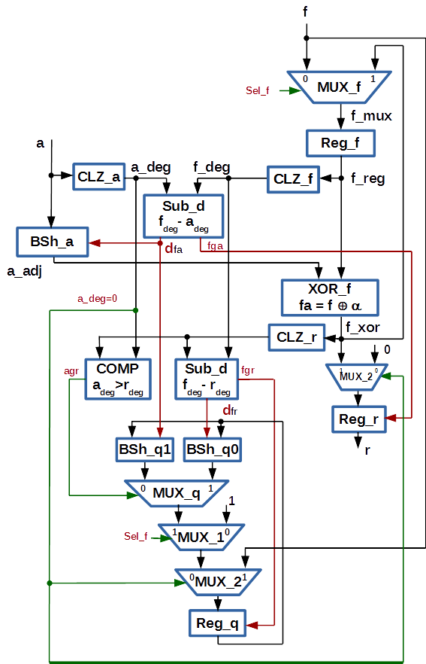
The BDA Module and Algorithm
INPUT: a(x) & f(x)
OUTPUT: r and q.
1. a←ax, f← fx .
2. r←0, q←1.
3. WHILE f_deg>a_deg DO
3.1 dfa←f_deg - a_deg.
3.2 a←a <<dfa.
3.3 r←a xor f.
3.4 dfr←f_deg – r_deg.
3.5 IF r_deg>a_deg THEN
q←(q<<dfr) + 1.
3.6 ELSE
q←q<<dfa.
4. Return(r, q).

Slide 6
FSM Controller
___
Start
S0
Input fx, ax
En_a
En_Ext
S1
Sel_f
Sel_Ext
Start
__ ___ ______
r0 . (dfr0 + a_deg0)
__ __
fgea + dfr0
En_a, En_Ext
S3
Done
__ ___ ______
r0 . (dfr0 + a_deg0)
S2
Sel_a
Sel_Ext

Slide 7
Design Requirements:
The main focus in the design was on the Functionality
3 Registers for the Extention circuit
3 Registers for the BDA circuit
1 Multiplier and 1 XOR for the Extention circuit
2 Subtractors (SADs), 3 Barrel Shifters, 1 XOR, and 3 CLZ circuits for the BDA circuit
  SAD: Sum of Absolute Diffrence Circuit

